Slide 1
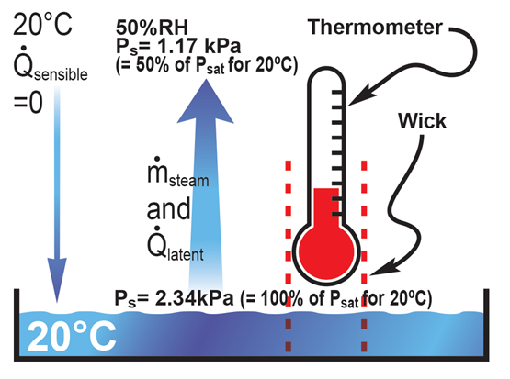
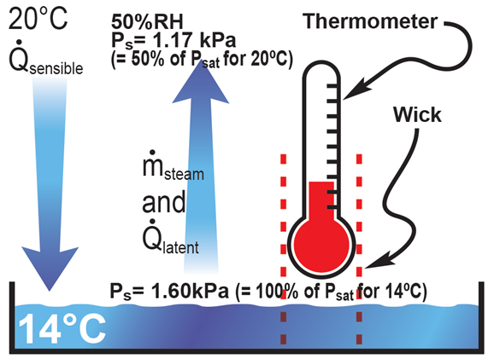
Evaporative Cooling Effect
Since the air stream and the water are both at 20ºC there is no driving temperature difference for sensible heat transfer from the air to the water. Where does energy for evaporation come from?

Slide 2
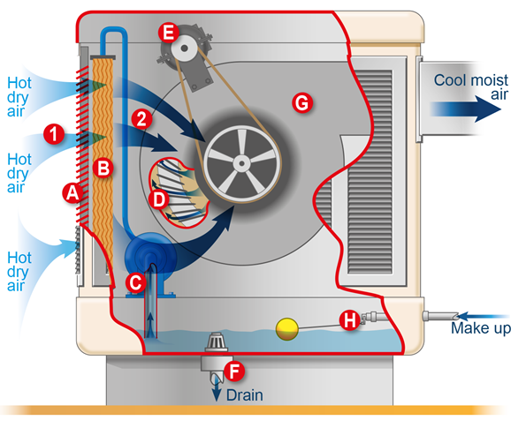
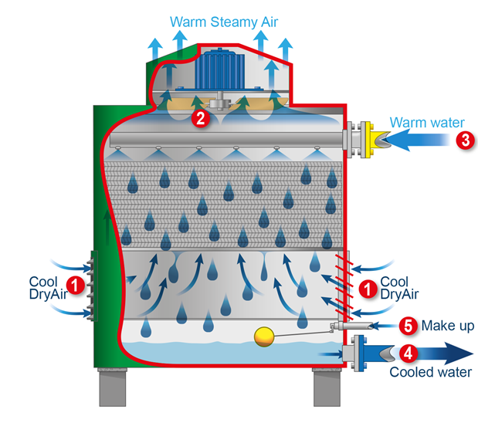
Evaporative Coolers vs Cooling Towers
Evaporative Cooler
Cooling Tower

Slide 3
MIET2039: Air conditioning Lab Exercise
Semester 2, 2015

Slide 4
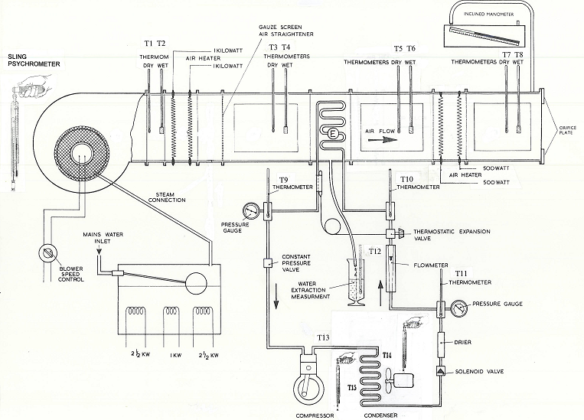
Schematic

Slide 5
Measurements - Air conditioning section
Location | DBT (ºC) | WBT (ºC) | RH % | W (g/kg d.a.) | h (kJ/kg)
1. Air entering fan | 27.0 | 23.1 |  |  | -
 | passes through a humidifier
2. Air leaving fan | T1 = 29.6 | T2 = 26.0 |  |  | -
 | Air passes through pre-heater (was not working)
3. Air entering cooling coil | T3 = 28.0 | T4 = 27.0
4. Air leaving cooling coil | T5 = 22.5 | T6 = 22.0
 | Air passes through heater |  |  |  |  | specific V
5. Air leaving unit | T7 = 27.0 | T8 = 24.0
sketch the cooling and heating sections on the psychrometric chart.
Find RH, W, h and specific volume

Slide 6
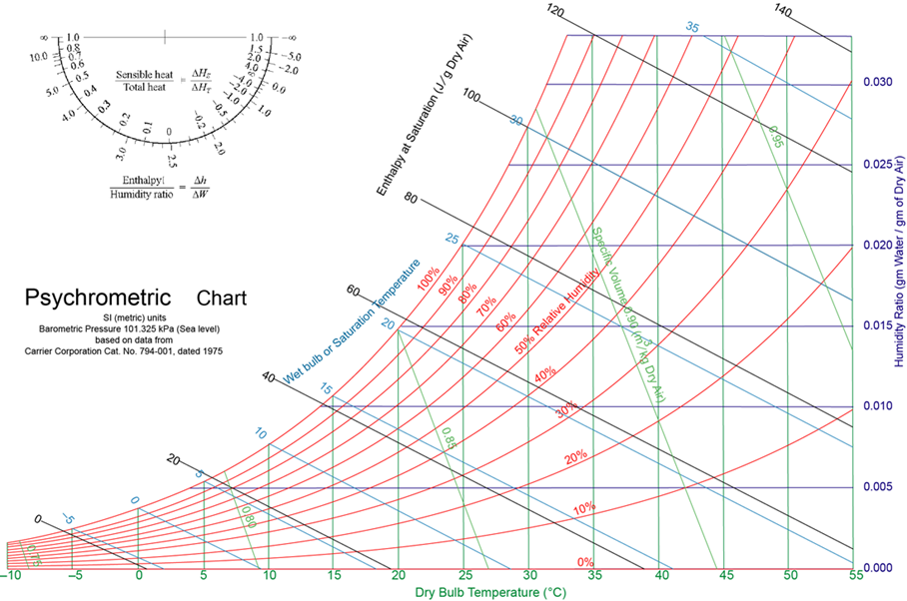

Slide 7
Measurements - Air conditioning section
Location | DBT (ºC) | WBT (ºC) | RH % | W (g/kg d.a.) | h (kJ/kg)
1. Air entering fan | 27.0 | 23.1 | 73 | 16.3 | -
 | passes through a humidifier
2. Air leaving fan | T1 = 29.6 | T2 = 26.0 | 79 | 20.1 | -
 | Air passes through pre-heater (was not working)
3. Air entering cooling coil | T3 = 28.0 | T4 = 27.0 | 91 | 22.1 | 85.0
4. Air leaving cooling coil | T5 = 22.5 | T6 = 22.0 | 97 | 16.4 | 64.5
 | Air passes through heater |  |  |  |  | specific V
5. Air leaving unit | T7 = 27.0 | T8 = 24.0 | 79 | 17.8 | 72.0 | 0.874

Slide 8
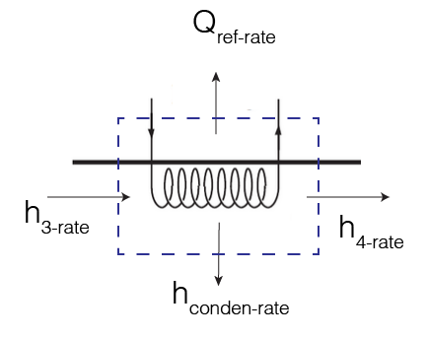
Calculations - Air conditioning section
Calculate the mass flow rate of dry air if the volumetric flow rate was measured as 565m³/hr. (use specific volume and the volumetric flow rate)
What is the condensation rate being formed and leaving the air conditioner across the cooling coil? (find net W and multiply by mass flow rate)
What is the rate of enthalpy leaving due to condensation if the condensate temperature is 25ºC? (find h of condensate and multiply by mass flow rate)
What is the rate of enthalpy entering and leaving the cooling coil? (find net enthalpies and multiply by mass flow rate)
Using the conservation principle, calculate the cooling load, Q_{ref}?
Based on the psychrometric chart what is the ADP?

Slide 9
Measurements - Refrigeration section
Refrigerant mass flow rate was 40.3 kg/hr
The refrigerant R134a liquid about to enter the expansion valve is at 920 kPa gauge pressure and T11 = 39ºC
After expansion valve refrigerant T10 = 8ºC (e.g. temperature before entering the evaporator/cooling coils)
After evaporator the gauge pressure is 290kPa = 391 kPa absolute with temperature T9 = 11.5ºC
Condenser inlet temperature T13 = 74ºC
Sketch the refrigeration cycle.

Slide 10
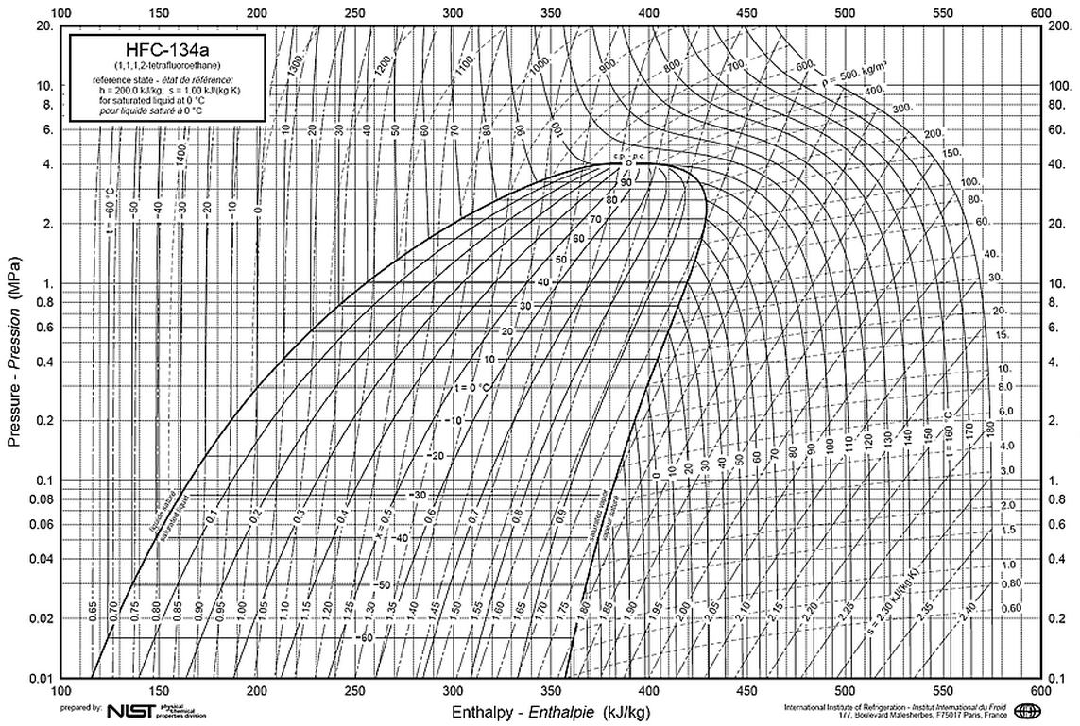
condenser
evaporator

Slide 11
Calculations - Refrigeration section
What is the coil surface temperature in the evaporator?
What is the heat transfer rate of the refrigerant in the evaporator?
What is the heat transfer rate of the refrigerant in the condenser?
What is the COP of this cycle?

Slide 12
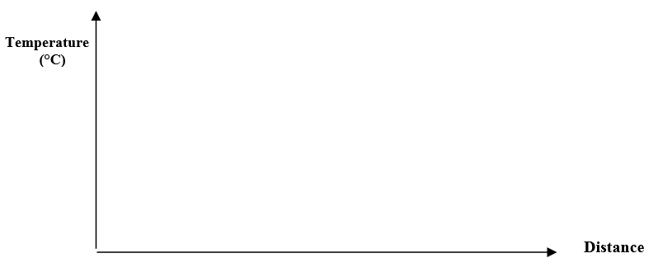
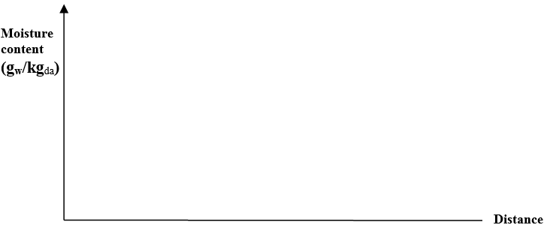
Discussion
Indicate on the psychrometric chart the likely “apparatus dew point” according to “straight line law” and comment on its value compared to the refrigerant evaporator temperature.
Sketch a temperature distribution and moisture content distribution through the cooling coil, making the assumption for the purposes of this sketch that the apparatus dew point is uniform across the coil. On each of the sketches also show the air temperature/moisture at the coil interface.

